Slide 1
Team Epidemics Deliverable 1 Presentation video:
https://youtu.be/8esRP6-Zzxg

Slide 2
Team Epidemics
Team Topic Presentation
2/25/2018

Slide 3
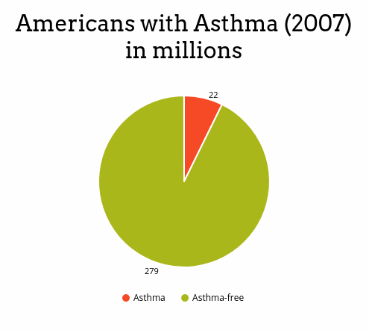

Slide 4
Asthma
Different age groups and asthma control levels have different recommended treatments
Asthma control informs how treatment needs to change over time.
Monitoring can either be based on symptom frequency or peak flow (ability to push a lot of air out at once as measured by a device)
Treatment adjustment is step-wise. I.e. If current treatment level is not sufficient at asthma control “step-up” to the next level of treatment, and step-down when possible

Slide 5
Expert Panel Report - 3
An updated report providing providers guidelines for diagnosis and management of asthma, created by gathering knowledge from medical experts and the literature. Included is an ask to help disseminate to the provider community.
Introduces a focus on monitoring asthma control
Impairment: fewer symptoms and lower negative impact on quality of life
Risk: acute e.g. ED visits and chronic e.g. reduced lung growth over time
Places emphasis on patient and provider education about asthma treatment

Slide 6
In a study published in Pediatrics in 2010, researchers from the Children’s hospital of Philadelphia used a cluster-randomized trial to produce evidence suggesting that using an EHR-based clinical decision support system at the point of care improved clinician compliance with National Asthma Education Prevention Program guidelines.
In 2015, researchers from the same group found that patients, families, and providers using an EHR-linked asthma portal to monitor asthma control as input to a clinical decision support system improved clinically meaningful outcomes compared to the clinician-focused clinical decision support systems from the 2010 study alone.

Slide 7
Business Case: The Problem
In America, 3,615 people die every year from asthma. Many of these deaths are avoidable with proper treatment and care.²
Worldwide, 250,000 people per year die unnecessarily from Asthma¹.
References
1. World Health Organization. Global surveillance, prevention and control of chronic respiratory diseases: a comprehensive approach, 2007.
2. Centers for Disease Control and Prevention. Most Recent Asthma Data. http://www.cdc.gov/asthma/most_recent_data.htm

Slide 8
Business Case: Alternatives
Find a permanent cure for Asthma? No. Incurable at present.
Prevent inhalation of airborne irritant triggers? No. Impractical and limiting.
Schedule frequent pulmonologist consultations? Yes, But expensive, slow and not all medical providers are up do date on latest EPR-3 research.
Competitor Asthma management tracking websites such as http://myasthma.com

Slide 9
Business Case: Solution
An interactive website can educate Asthma sufferers using the latest EPR-3 research to help guide people toward optimal mitigation of Asthma.
Benefits to users and providers
Information for the user to understand the problem enough to self medicate.
Lower friction between healthcare provider and patient.
Data acquisition through surveys and health tracking devices through FHIR API’s

Slide 10
Business Case: Website Implementation
Interact with users and decide Asthma control Level
Suggests optimal mitigation techniques and medications, based on patient data
Education around contraindicated medications
Adjusting and maintaining patient therapy and medications
FHIR API’s monitor and exchange vitals/assessments to care provider
Education around preventative self-care

Slide 11
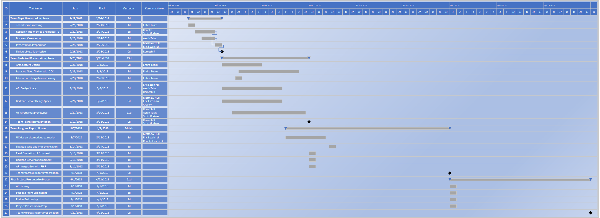
Gantt Chart of our project plan identifying resource allocations:

